Slide 1
Lesson 8:
Advanced Numerics
& Arrays
By: Ryan Alterman
Revised: 9-14-17

Slide 2
What are Advanced Numerics?
They are in essence just C++ versions of advanced math functions
They are defined the same way
Still just type identifier = value;
Can now use operations like:
Trigonometry
Logarithms
Exponential
Square Roots
Absolute Value
These require you to add an include file
<cmath>

Slide 3
Trig Operations
Cosine
double cos(double);
Returns the cosine of an angle in double
SIne
double sin(double);
Returns the sine of an angle in double
Tangent
double tan(double);
Returns the tangent of an angle in double
Hypotenuse
double hypot(double, double);
Given two sides of a triangle, it will calculate the hypotenuse.

Slide 4
Logarithms, Exponents, and Absolute Values
Logarithms
double log(double);
Takes the natural log of a number
Power
Double pow(double, double);
Raises the first parameter by the second parameter.
Square Root
double sqrt(double);
Absolute Value
int abs(int);
double fabs(double);

Slide 5
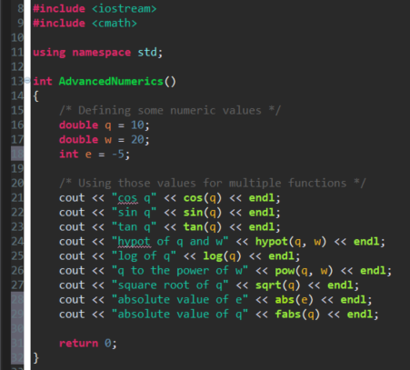
How to call the functions

Slide 6
Arrays
They are places for you to store many values for one variable
These values can be stored and called again at any time
This is done by accessing the spot in which the number is saved to.
Declaration
Type identifier [ arraySize ];
The type can be any kind of type that you want
The arraySize must be an integer greater than 0
Or, you can leave the array size blank and will adjust the array size automatically
I.e
int numbers [ 10 ]
This declares an integer array with the name number and a total size of 10
Important Note:
The number slot in which a value is stored is called an index and every array starts with an index of 0 and continues from there.

Slide 7
Initialization
This is where you actually give the array a value
This can be done in a large group all at once or individually
Multiple:
Type identifier [ arraySize ] = { elements };
Individually:
Identifier [ indexValue ] = value;

Slide 8
Indexing an Array
This is how you access the values stored in an array
Variable = array [ indexValue ];
So if you were to call the 5th index, you would be calling the value of the 6th element
I.e.
Array [ 5 ] = {1, 2, 3, 4, 5, 6};
Variable = Array [ 5 ];
The Variable value is now equal to 6.

Slide 9
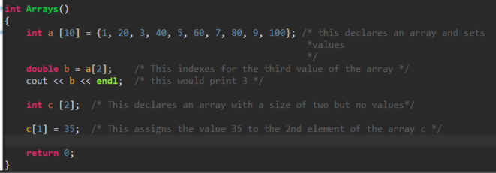
A one dimensional array

Slide 10
Multi-Dimensional Arrays
The arrays that we just defined are one-dimensional
They only have one set of values
Arrays can have more than one set of values
This is where you get two-dimensional arrays and up
type identifier [size1] [size2] … [ sizeN];
When accessing multidimensional arrays, it becomes like coordinates
identifier [index 1] [index 2] … [index N];
So think of values being stored in terms of rows and columns

Slide 11
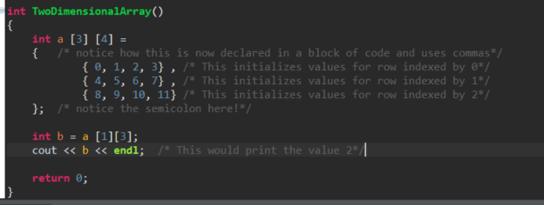
A two-dimensional array

Slide 12
Challenge
We are just going to have a discussion this time. How would you be able to see these math functions and arrays being able to be used on a robot. Then let’s design the code and see what is might look like.

Slide 13
Next: Pointers/References

